Slide 1
ET8205 Introduction to Measurement Systems

Slide 2
MEASUREMENT & INSTRUMENTATION
Measurement
Is the quantification of attributes of an object or event, which can be used to compare with other objects or events.
Is the process of associating numbers with physical quantities and phenomena.
Instrumentation
Instrumentation is a collective term for measuring instruments that are used for indicating, measuring and recording physical quantities.
When used as verbs, instrument means to apply measuring devices, whereas measure means to ascertain the quantity of a unit of material via calculated comparison with respect to a standard.

Slide 3
MEASUREMENT SYSTEM
A measurement system exists to provide information about the physical value of some variable being measured.
In simple cases, the system can consist of only a single unit that gives an output reading or signal according to the magnitude of the unknown variable applied to it.
In more complex measurement situations, a measurement system consists of several separate elements

Slide 4
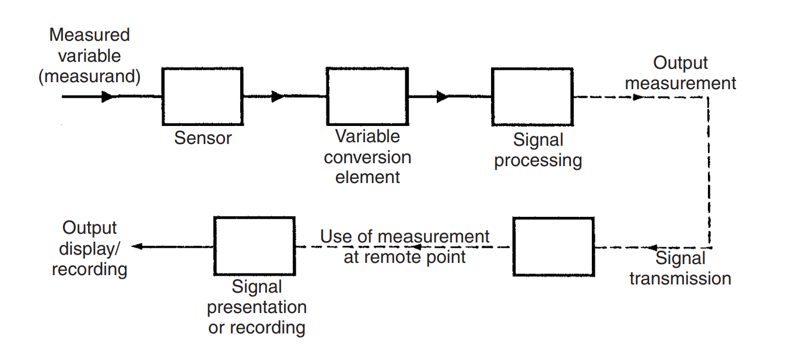
ELEMENTS OF A MEASUREMENT SYSTEM

Slide 5
ELEMENTS OF A MEASUREMENT SYSTEM…
Primary sensor
This gives an output that is a function of the input applied to it (the measurand)
Some examples of primary sensors are a liquid-in-glass thermometer, a thermocouple and a strain gauge.
In the case of the mercury-in-glass thermometer, the output reading is given in terms of the level of the mercury, and so this particular primary sensor is also a complete measurement system in itself. However, in general, the primary sensor is only part of a measurement system.

Slide 6
ELEMENTS OF A MEASUREMENT SYSTEM…
Variable conversion elements
These are needed where the output variable of a primary transducer is in an inconvenient form and has to be converted to a more convenient form.
For example, the displacement-measuring strain gauge has an output in the form of a varying resistance. The resistance change cannot be easily measured and so it is converted to a change in voltage by a bridge circuit, which is a typical example of a variable conversion element.
In some cases, the primary sensor and variable conversion element are combined, and the combination is known as a transducer.

Slide 7
ELEMENTS OF A MEASUREMENT SYSTEM…
Signal processing elements
This exists to improve the quality of the output of a measurement system in some way.
A very common type of signal processing element is the electronic amplifier, which amplifies the output of the primary transducer or variable conversion element, thus improving the sensitivity and resolution of measurement.
This element of a measuring system is particularly important where the primary transducer has a low output.
For example, thermocouples have a typical output of only a few millivolts.

Slide 8
ELEMENTS OF A MEASUREMENT SYSTEM…
Signal transmission
This is needed when the observation or application point of the output of a measurement system is some distance away from the site of the primary transducer.
Sometimes, this separation is made solely for purposes of convenience, but more often it follows from the physical inaccessibility or environmental unsuitability of the site of the primary transducer for mounting the signal presentation/recording unit.
The signal transmission element has traditionally consisted of single or multi-cored cables example fibre-optic cables are being used because of their low transmission loss and resistance to the effects of electrical and magnetic fields.

Slide 9
ELEMENTS OF A MEASUREMENT SYSTEM…
Output display/ recording element
This is the device that is used to display the final reading of the measured quantity.
For example LCD (Liquid Crystal Display), CRO (Cathode Ray Oscilloscope)

Slide 10
Selection Criteria for Measurement Systems
The starting point in choosing the most suitable instrument to use for measurement of a particular quantity in a manufacturing plant or other system is the specification of the instrument characteristics required, especially parameters like the desired measurement accuracy, resolution, sensitivity and dynamic performance.
It is also essential to know the environmental conditions that the instrument will be subjected to, as some conditions will immediately either eliminate the possibility of using certain types of instrument or else will create a requirement for expensive protection of the instrument.
Therefore the one choosing the instrument should have ample information on the operation in question.

Slide 11
Selection Criteria for Measurement Systems…
Then, a skilled instrument engineer, having knowledge of all the instruments that are available for measuring the quantity in question, will be able to evaluate the possible list of instruments in terms of their accuracy, cost and suitability for the environmental conditions and thus choose the most appropriate instrument.
To summarize therefore, instrument choice is a compromise between performance characteristics, ruggedness and durability, maintenance requirements and purchase cost.
To carry out such an evaluation properly, the instrument engineer must have a wide knowledge of the range of instruments available for measuring particular physical quantities, and he/she must also have a deep understanding of how instrument characteristics are affected by particular measurement situations and operating conditions.

Slide 12
SI System
This is the International System of Units known by the international abbreviation SI.
There are major two types of units:
Fundamental units (Base units)
Derived units

Slide 13
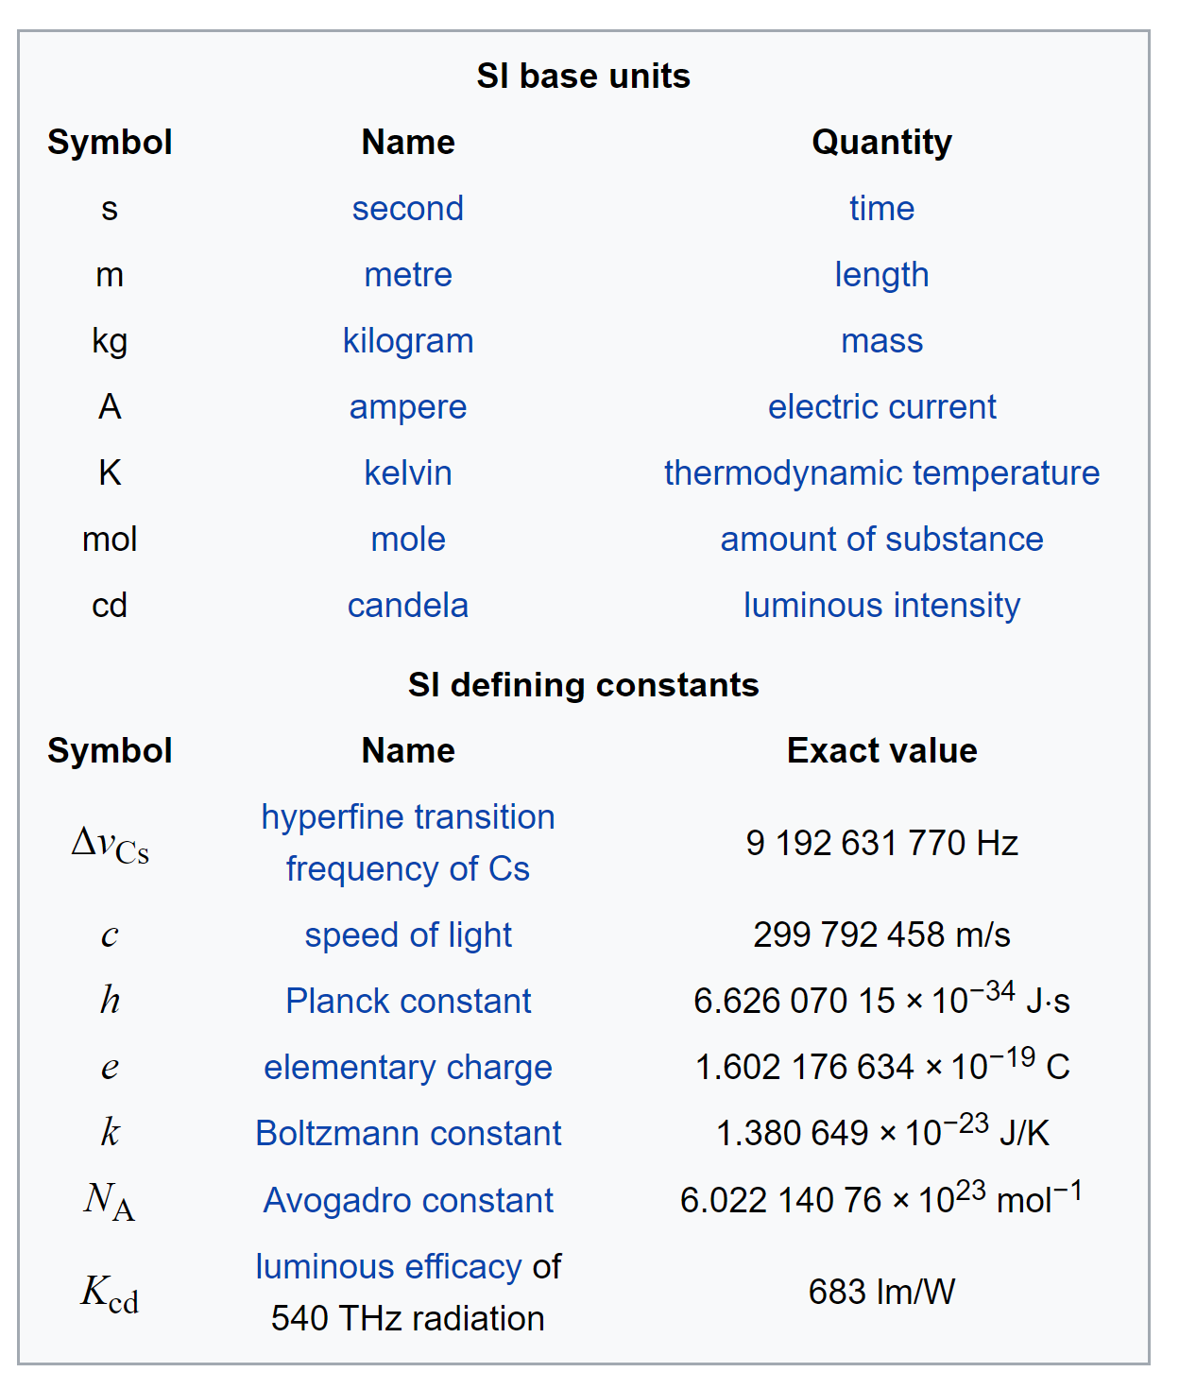
SI System

Slide 14
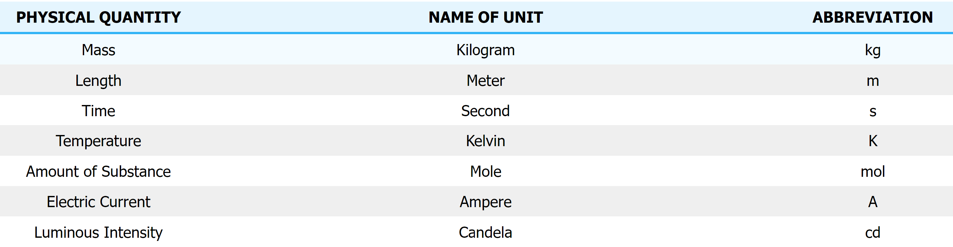
Fundamental units (Base units)
The SI contains seven BASE UNITS that each represent a different kind of physical quantity.

Slide 15
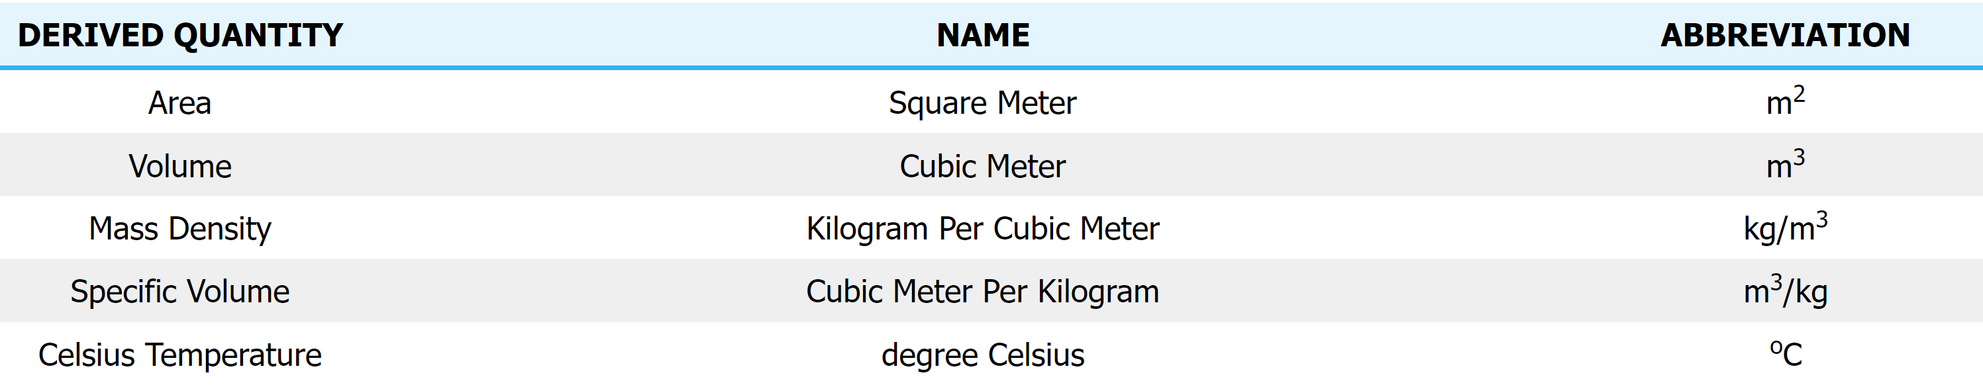
Derived units
Derived Units are created by mathematical relationships ​between other Base Units and are expressed in a combination of fundamental and base quantities.

Slide 16
Rules and conventions for writing SI units and their symbols
1. The units named after scientists are not written with a capital initial letter.
For example :newton, henry, watt
2. The symbols of the units named after scientist should be written by a capital letter.
For example : N for newton, H for henry, W for watt
3. Small letters are used as symbols for units not derived from a proper name.
For example : m for metre, kg for kilogram
4. No full stop or other punctuation marks should be used within or at the end of symbols.
For example : 50 m and not as 50 m.
5. The symbols of the units do not take plural form. For example : 10 kg not as 10 kgs

Slide 17
Rules and conventions for writing SI units and their symbols…
6. When temperature is expressed in kelvin, the degree sign is omitted.
For example : 273 K not as 273o K
(If expressed in Celsius scale, degree sign is to be included. For example 100℃ and not 100 C)
7. Use of solidus is recommended only for indicating a division of one letter unit symbol by another unit symbol. Not more than one solidus is used. For example : m s-1 or m / s, J / K mol or J K-1 mol-1 but not J / K / mol.
8. Some space is always to be left between the number and the symbol of the unit and also between the symbols for compound units such as force, momentum, etc.
For example, it is not correct to write 2.3m. The correct representation is 2.3 m; kg m s-2 and not as kgms-2.

Slide 18
Rules and conventions for writing SI units and their symbols…
9. Only accepted symbols should be used.
For example : ampere is represented as A and not as amp. or am ; second is represented as s and not as sec.
10. Numerical value of any physical quantity should be expressed in scientific notation.
For an example, density of mercury is 1.36 x 104 kg m-3 and not as 13600 kg m-3.

Slide 19
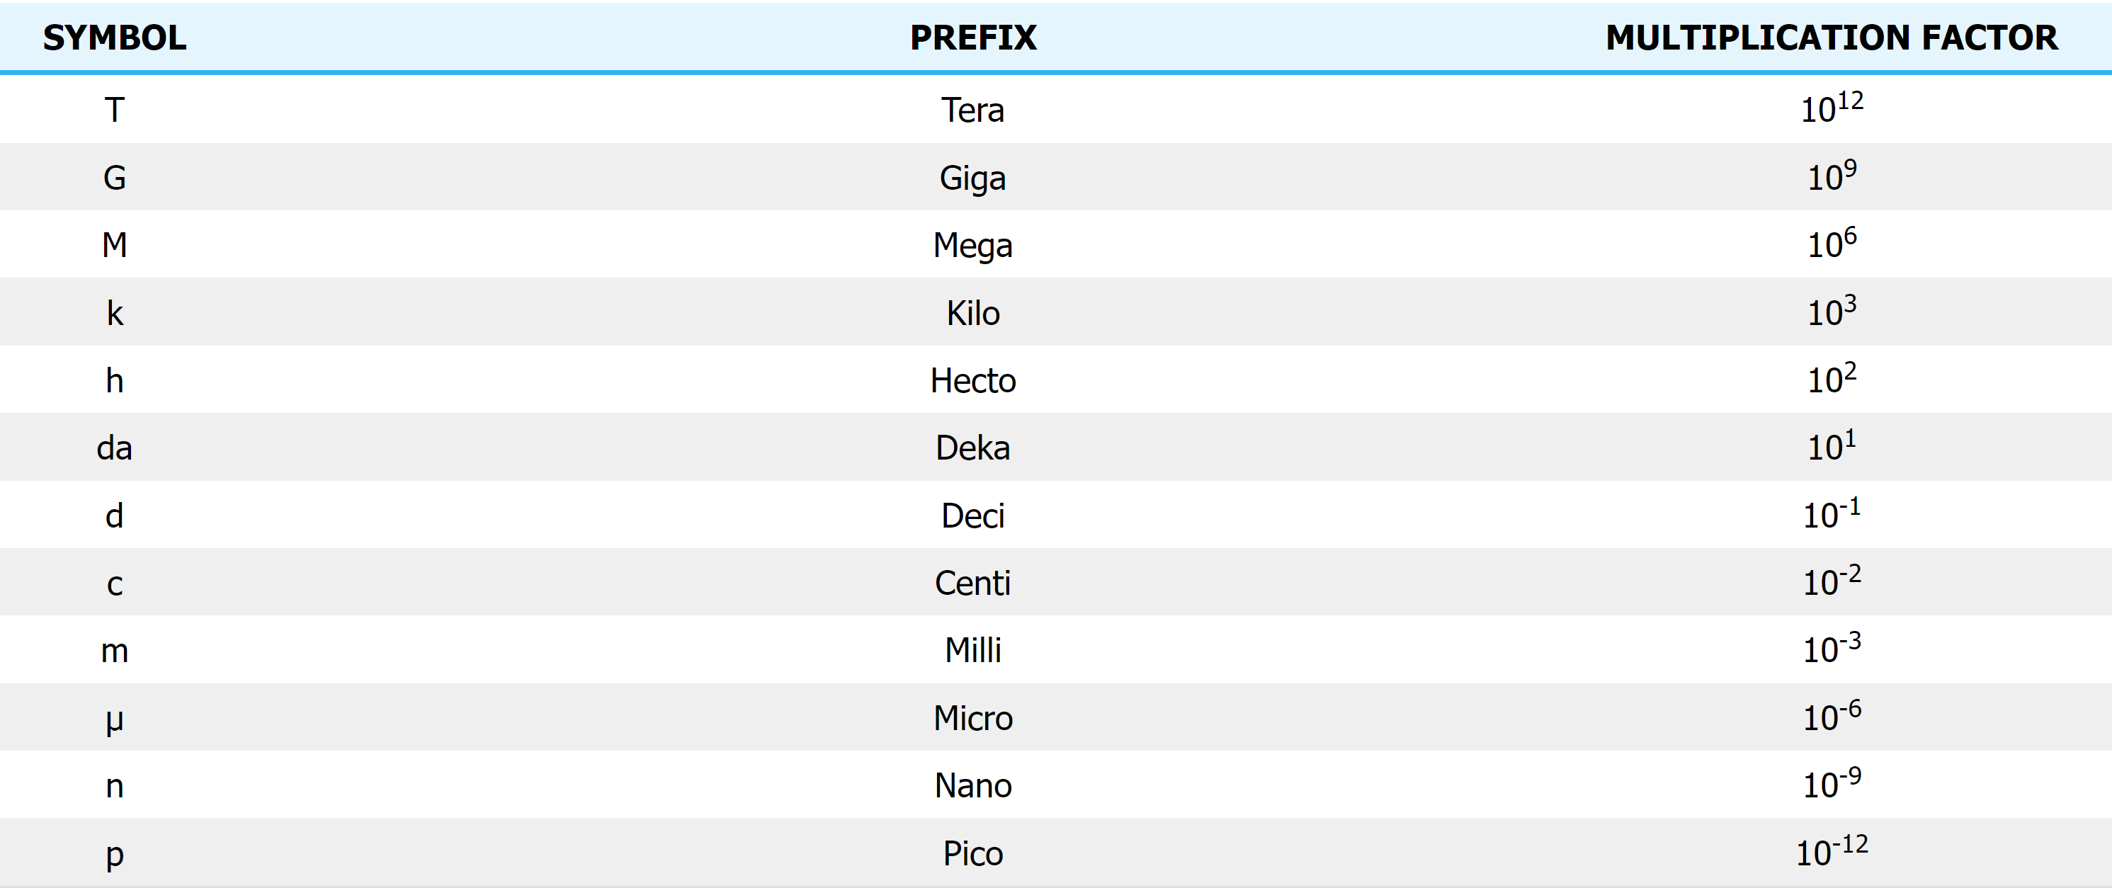
Prefixes
Metric units use a prefix, used for conversion from or to an SI unit. Below is a chart illustrating how prefixes are labeled in metric measurements.

Slide 20
Significant Figures
These are digits in the number that are reliable and absolutely necessary to indicate the quantity of something.
If a number expressing the result of measurement of something (e.g., length, pressure, volume, or mass) has more digits than the digits allowed by the measurement resolution, only the digits allowed by the measurement resolution are reliable and so only these can be significant figures.
For example, if a length measurement gives 114.8 mm while the smallest interval between marks on the ruler used in the measurement is 1 mm, then the first three digits (1, 1, and 4, and these show 114 mm) are only reliable so can be significant figures

Slide 21
Discuss..
Measurement and Instrumentation
SI units
Prefixes
Elements of a measurement system
Rules for writing SI units and symbols.

